Slide 1

EXECUTIVE BRIEFING · JAN 2025 – AUG 2026
Swiggy
Food Delivery
Performance
Review
Operational baseline, revenue definitions, and strategic data priorities.
Leadership Performance Audit
Recorded vs. Delivered Analysis
Dataset scope: 50,000 distinct orders · 8 metro markets
01
Notes:
Welcome leadership. Today's review covers our performance audit spanning 50,000 orders across eight key cities between January 2025 and August 2026, establishing where our revenue stands and where data rigor must improve.

Slide 2
TOP-LINE METRICS
Recorded revenue reached ₹26.87M across 50,000 orders
Performance overview across the complete 20-month operating record.
50,000
₹26.87M
₹525.58
4.11 / 5
Distinct Orders
Recorded Revenue
Average Order Value
Average Rating
Recorded between Jan 2025 and Aug 2026
Aggregated across all logged transactions
Average basket size across all records
Calculated from rated orders only
Jan 2025 – Aug 2026 dataset · Ratings average excludes 3,487 unrated or cancelled rows
02
Notes:
Overall recorded transaction volume reached 26.87 million rupees from 50,000 distinct orders, with an average basket value of 525 rupees and a solid customer rating of 4.11 out of 5.

Slide 3
88% of orders were delivered, so the revenue figure needs a definition
Order status
Revenue definition
Delivered: 43,953 orders (87.91%)
Cancelled: 3,487 orders (6.97%)
Delayed: 2,560 orders (5.12%)
Delivered-only revenue: ₹23.59M, versus ₹26.87M recorded across all statuses
03

Slide 4
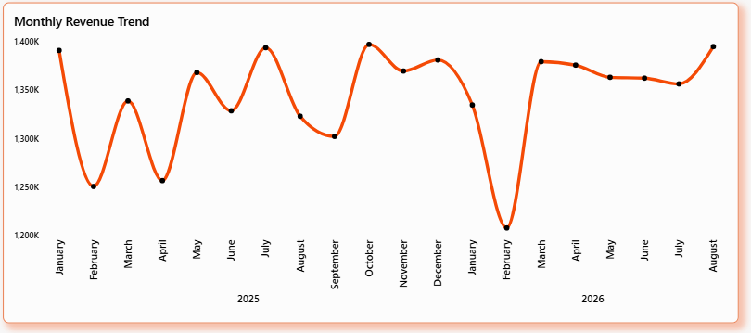
TREND ANALYSIS
Monthly revenue held between ₹1.2M and ₹1.4M
PERFORMANCE RANGE
Stable Monthly Cadence
Peak month: October 2025, at ₹1,396,906.86.
Lowest month: February 2026, the one clear dip.
Note: 2026 is a partial year, so compare equivalent months only.
Monthly aggregate recorded revenue · October 2025 peak: ₹1.40M · February 2026 trough: ₹1.24M
04
Notes:
Monthly revenue demonstrates remarkable consistency, staying tightly bounded between 1.2M and 1.4M rupees. October 2025 was our high point, while February 2026 represented our only material dip.

Slide 5
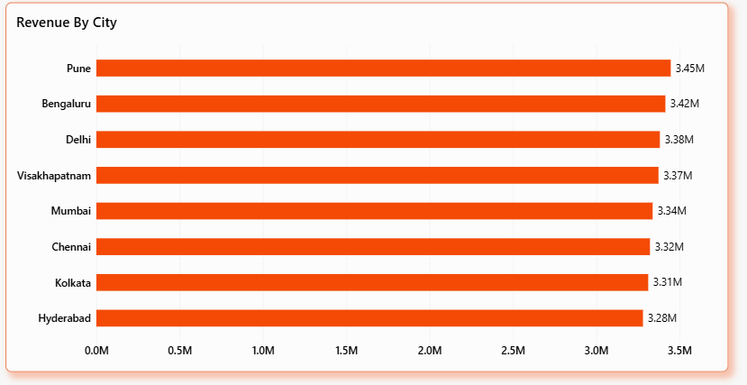
GEOGRAPHIC DISTRIBUTION
Revenue is spread evenly across eight cities
MARKET UNIFORMITY
Top-to-Bottom Delta
₹167k
Pune leads at ₹3.45M; Hyderabad is lowest at ₹3.28M.
The ₹166,962 gap means city ranking alone should not drive decisions.
Recorded revenue by city · Total delta: ₹166,962 across 8 distinct metro operations
05
Notes:
Revenue distribution is flat across all eight operating territories. With Pune generating 3.45M and Hyderabad at 3.28M, the narrow 167k gap means resource allocation should look past headline city totals.

Slide 6
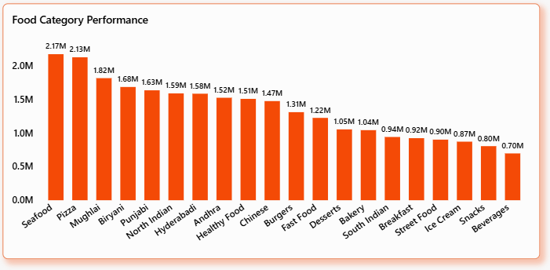
Seafood and Pizza lead food categories by recorded revenue
CATEGORY HIGHLIGHTS
Seafood: ₹2.17M
Pizza: ₹2.13M
Beverages: ₹0.70M, the smallest category
06

Slide 7
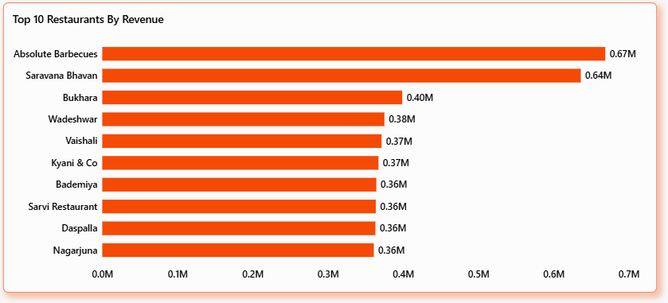
Absolute Barbecues is the top restaurant at ₹0.67M
Absolute Barbecues
Saravana Bhavan
Bukhara
₹668,689
₹636,128, a close second
₹398,788 , at Third Place
07
Notes:
Absolute Barbecues leads partner revenue at approximately 669k rupees, closely followed by Saravana Bhavan at 636k. Our immediate priority is distinguishing volume-driven leaders from ticket-size beneficiaries.

Slide 8
CORRELATION ANALYSIS
Longer trips take longer, while ratings barely respond to delivery time
Distance and delivery time
Delivery time and rating
0.57
-0.10
Positive correlation
Weak negative correlation
Limit: These show association, not cause; traffic and prep time are not in the data.
08
Notes:
Distance and delivery time: positive correlation of 0.57. Delivery time and rating: weak negative correlation of -0.10. These show association, not cause; traffic and prep time are not in the data.

Slide 9
Conclusion
The analysis of 50,000 food delivery orders highlights revenue patterns across cities, restaurants, and food categories, while exploring delivery efficiency and customer satisfaction.
Key Takeaways
Pune leads city-wise recorded net revenue.
Seafood is the highest-revenue food category.
Absolute Barbecues leads restaurant-wise recorded net revenue.
Delivery distance has a positive relationship with delivery time.
Delivery time has a weak negative relationship with customer ratings.
Business recommendations
09
Notes:
Before leadership relies on platform-wide averages, we must clean our data inputs. 3,487 rows had zero delivery times—mirroring cancellations. The true completed delivery average is 34.89 minutes.

Slide 10
Business Recommendations
Investigate revenue performance by city, restaurant, and food category.
Analyze cancellations and distinguish completed-order revenue from recorded revenue.
Review delivery times by distance and city to identify operational improvements.
Monitor customer ratings alongside delivery time and order status.
Improve data quality by validating missing ratings and zero delivery-time values.
10

Slide 11
THANK
YOU…!!!
11

